Slide 1
GRE Math
Ming

Slide 2
Knowledge structure
Introduction to GRE Math（GRE数学介绍）
The Number Properties（基本数论）
The Algebra（代数计算）
The Word Problems（文字应用题）

Slide 3
Introduction to GRE Math
GRE数学介绍

Slide 4
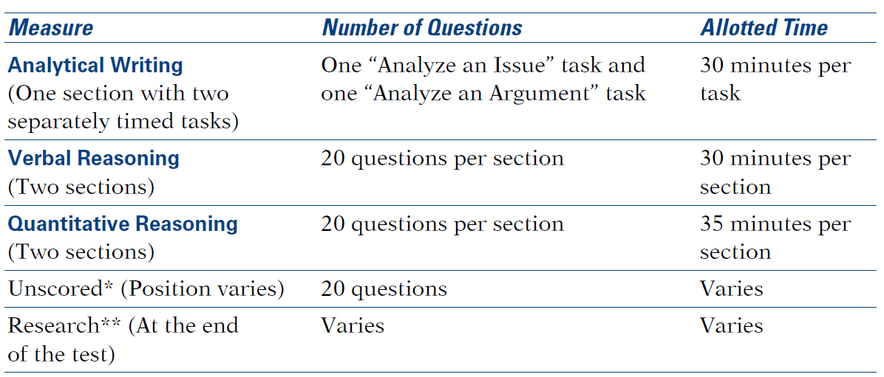
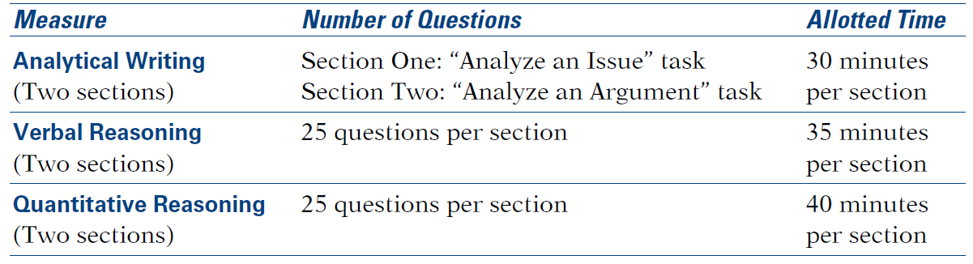
Introduction to GRE Math（GRE数学介绍）
Computer-delivered
Section Sequence
VQVQV
QVQVQ
Do NOT predict and give up unscored section!
Paper-delivered
Scores
130-170
Average of Chinese candidates
164 (Over 90% correct rate)

Slide 5
Question types（题型）
Quantitative Comparison questions
Multiple-choice questions—Select One Answer Choice
Multiple-choice questions—Select One or More Answer Choices
Numeric Entry questions

Slide 6
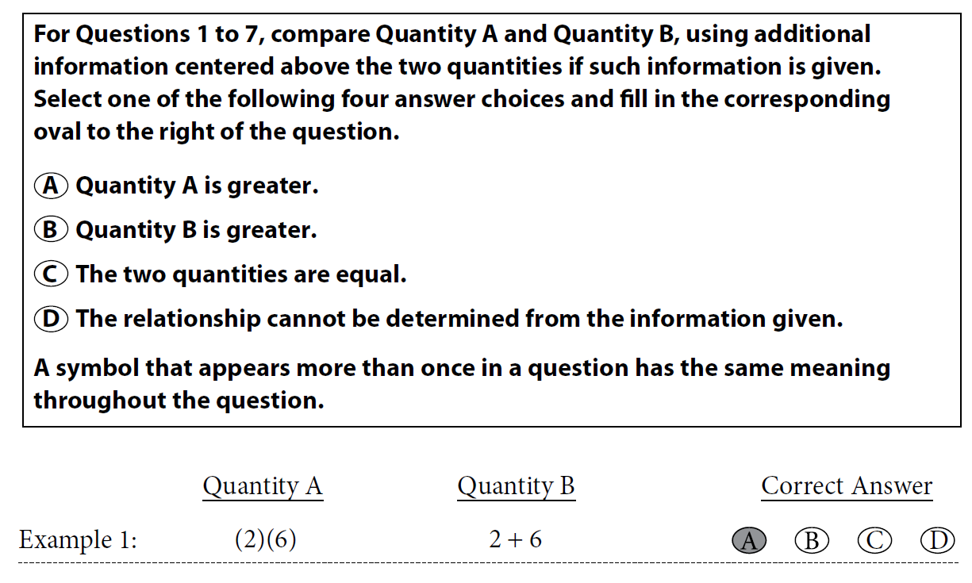
Question types（题型）
Quantitative Comparison questions

Slide 7
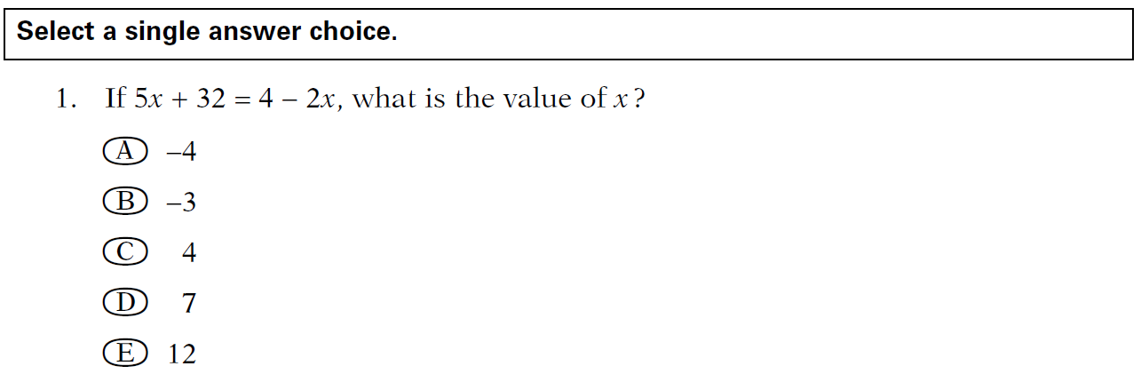
Question types（题型）
Multiple-choice questions—Select One Answer Choice
Notes:
A

Slide 8
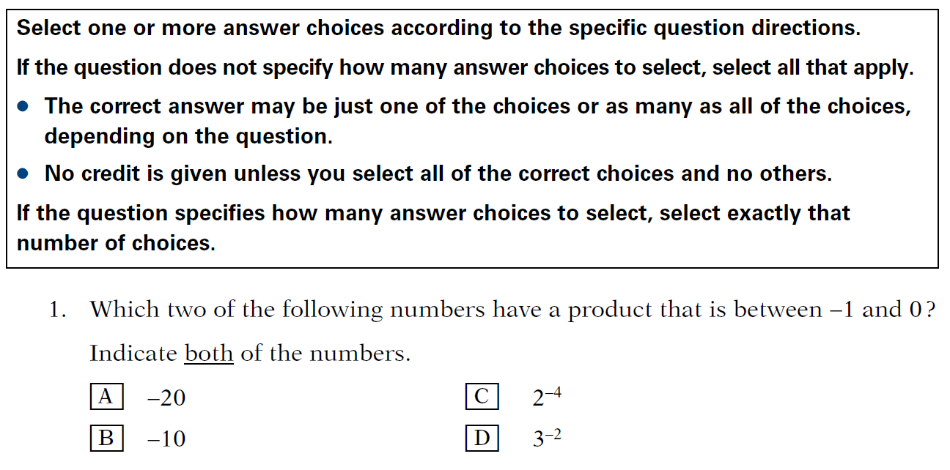
Question types（题型）
Multiple-choice questions—Select One or More Answer Choices
Notes:
B C

Slide 9
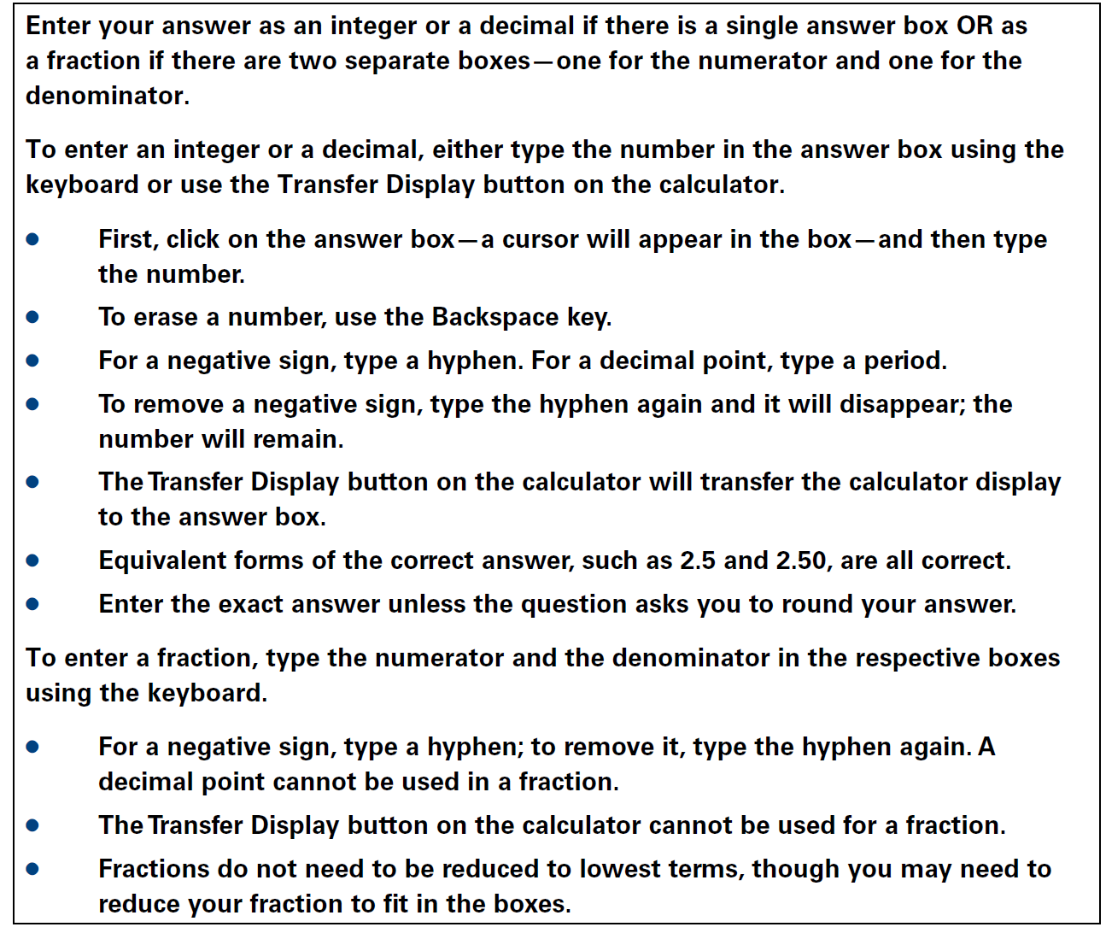
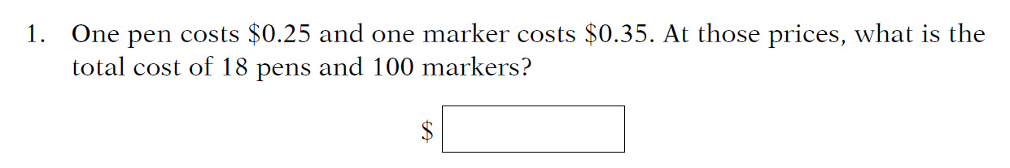
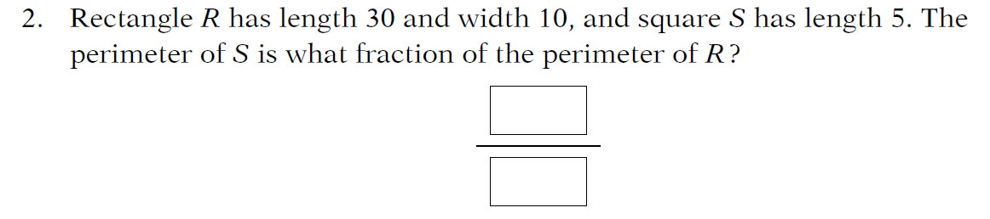
Question types（题型）
Numeric Entry questions
Notes:
39.5
20/80

Slide 10
The Number Properties
基本数论

Slide 11






Odd and Even Numbers（奇偶数）
Odd: {…-3, -1, 1, 3, 5,…}
2n+1
Even: {…-4, -2, 0, 2, 4…}
2n
Calculation:
$$Odd + Odd = Even$$
$$Odd × Odd =Odd$$
$$Odd + Even = Odd$$
$$Odd × Even =Even$$
$$Even + Even = Even$$
$$Even × Even = Even$$

Slide 12
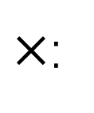
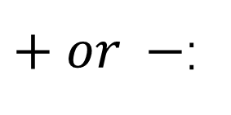
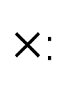
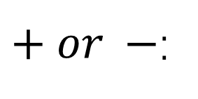
Odd and Even Numbers（奇偶数）
Two Numbers:
Even result: Same odd or same even
$+ or −$:
Odd result: Odd and even
Even result: At least one even
$×$:
Odd result: All odd
More Numbers:
Even result: Even number of Odd
$+ or −$:
Odd result: Odd number of Odd
Even result: At least one even
$×$:
Odd result: All odd

Slide 13
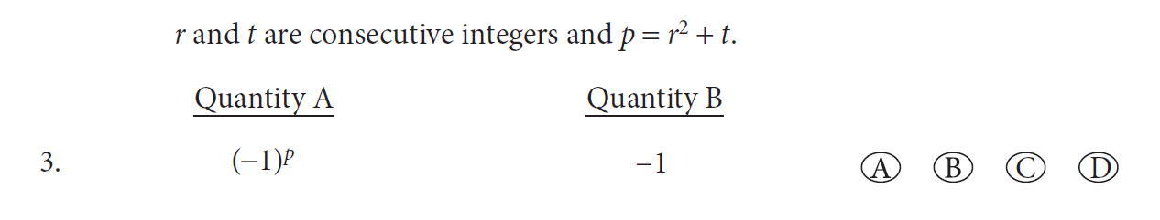
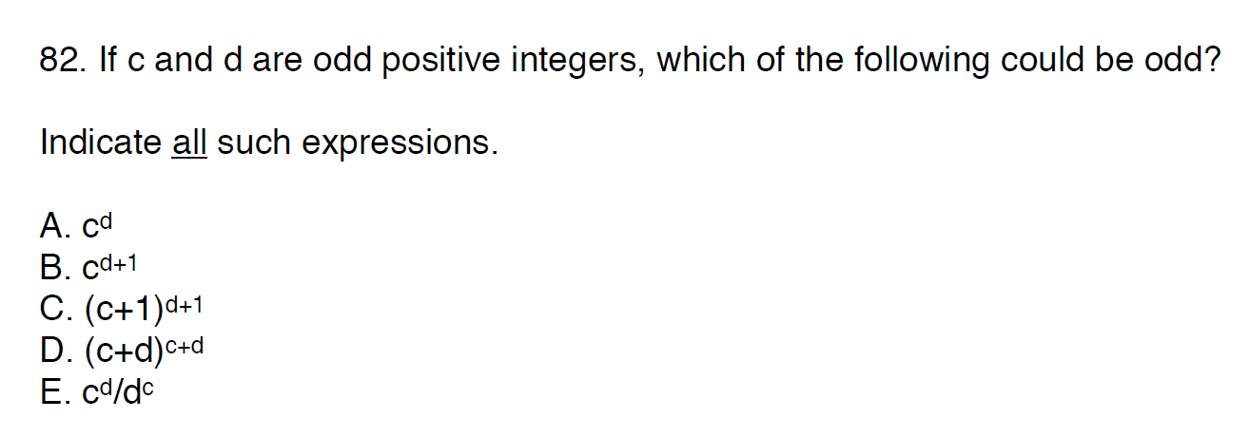
Odd and Even Numbers（奇偶数）
Notes:
C
ABE

Slide 14
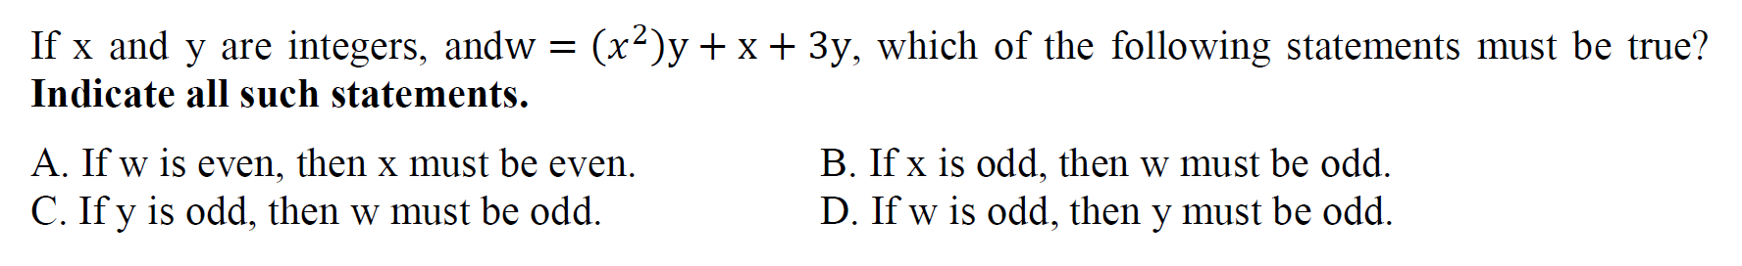
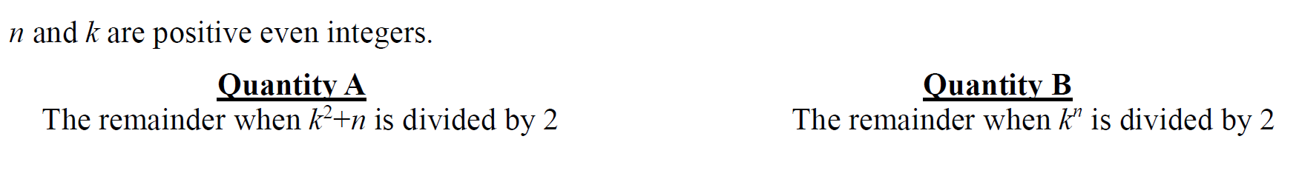
Odd and Even Numbers（奇偶数）
Notes:
ABC
C

Slide 15
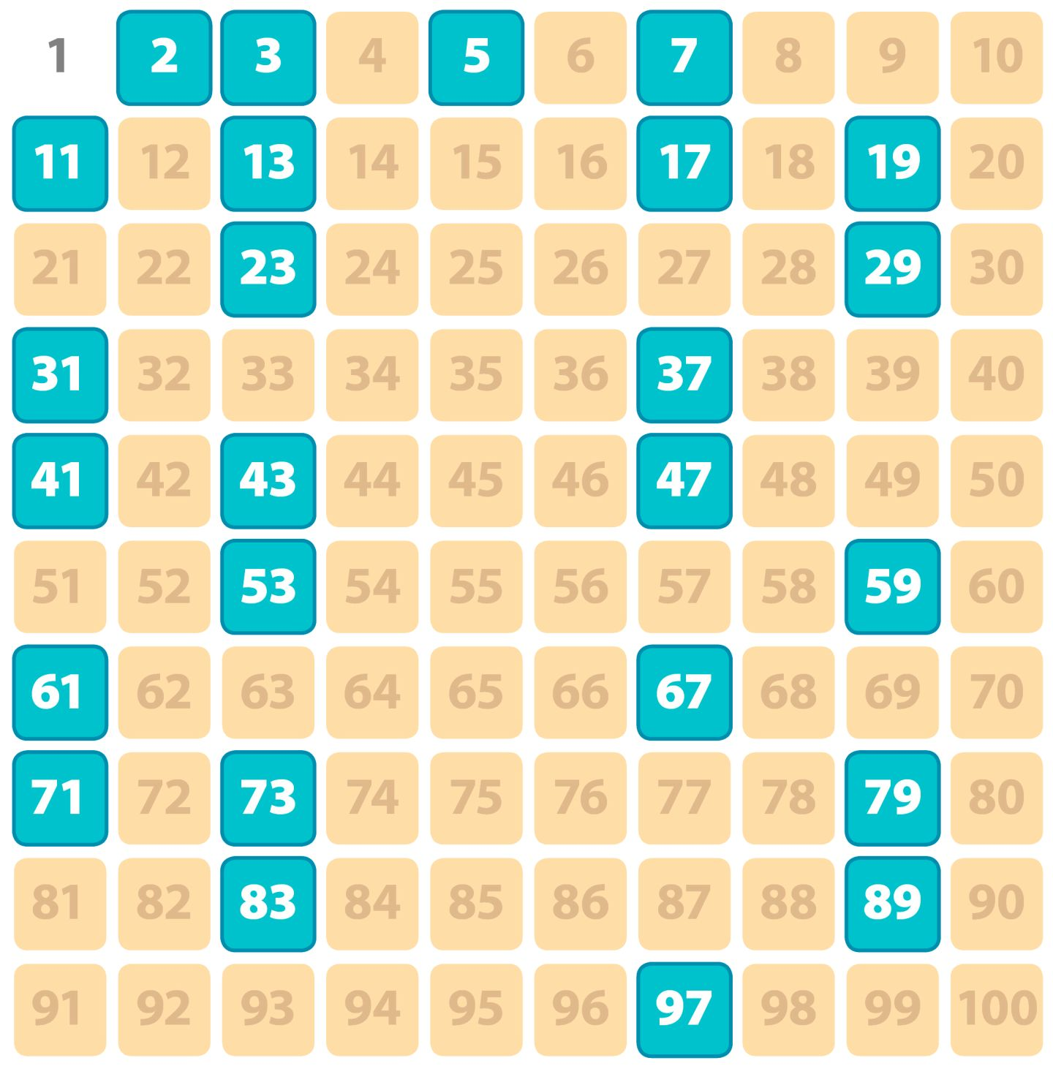
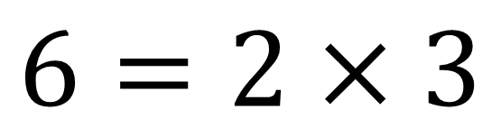
Factors and Prime Factors（因数和质因数）
Prime Number（质数）
Composite Number（合数）
$$6=2×3$$
Multiple
（倍数）
Factor
（因数、约数）
Divisor
（除数）
Notes:
Notice：1 and 2
How to find Prime factors

Slide 16
Factors and Prime Factors（因数和质因数）
Divisibility:
Divisible by 2: unit is 0, 2, 4, 6 or 8
Divisible by 3: sum of each digit is divisible by 3
Divisible by 4: last two digits are divisible by 4
Divisible by 5: unit is 0 or 5
Divisible by 6: divisible by 2 and 3
Divisible by 8: last three digits are divisible by 8
Divisible by 9: sum of each digit is divisible by 9
Divisible by 10: unit is 0
Divisible by 11: sum of digits in odd positions equals to the sum of those in even positions

Slide 17
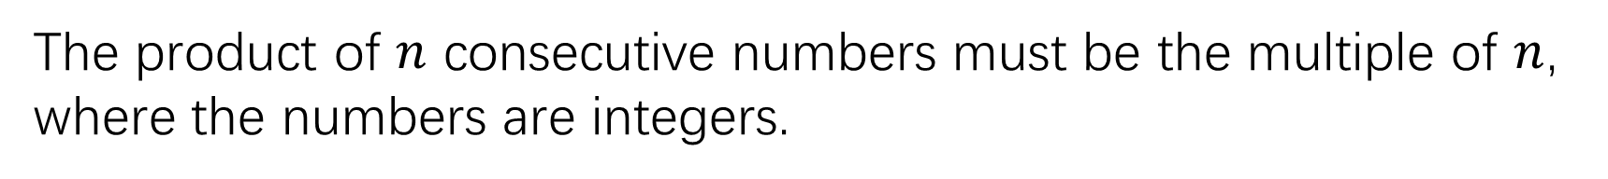
Factors and Prime Factors（因数和质因数）
Consecutive Numbers（连续数）
The product of $n$ consecutive numbers must be the multiple of $n$, where the numbers are integers.
Therefore,
The product of 2 consecutive numbers must be the multiple of 2.
The product of 3 consecutive numbers must be the multiple of 6.
The product of 4 consecutive numbers must be the multiple of 24.

Slide 18
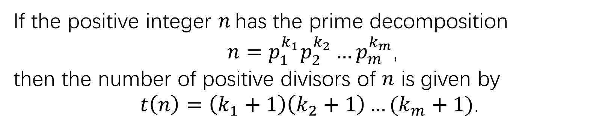
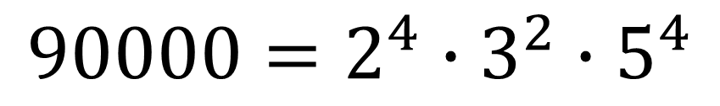
Factors and Prime Factors（因数和质因数）
Number of Factors:
If the positive integer $n$ has the prime decomposition
$n=p_{1}^{k_{1}}p_{2}^{k_{2}}…p_{m}^{k_{m}}$,
then the number of positive divisors of $n$ is given by
$t\left(n\right)=\left(k_{1}+1\right)\left(k_{2}+1\right)…(k_{m}+1)$.
$$90000=2^{4}∙3^{2}∙5^{4}$$
$$Number of Factors=(4+1)(2+1)(4+1)$$

Slide 19
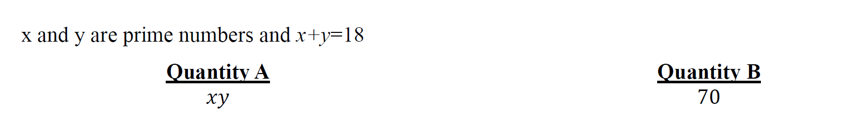
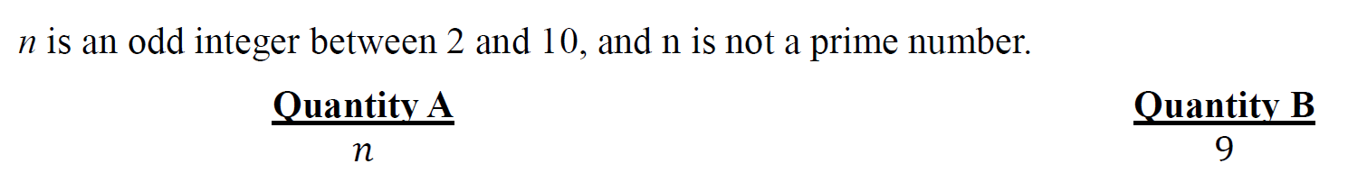
Factors and Prime Factors（因数和质因数）
Notes:
D
C

Slide 20
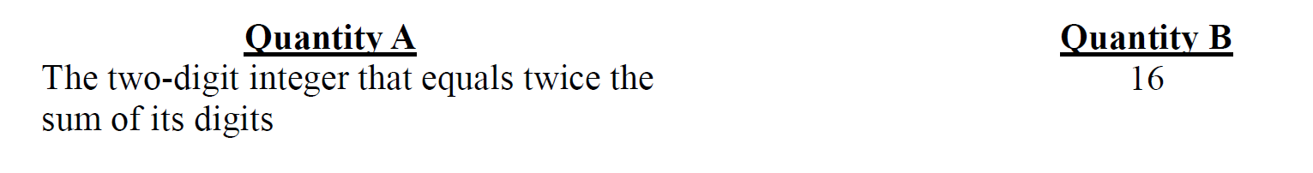
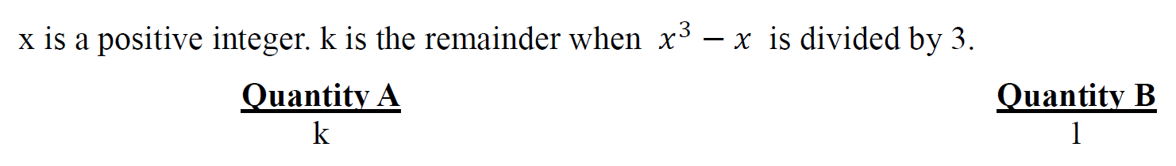
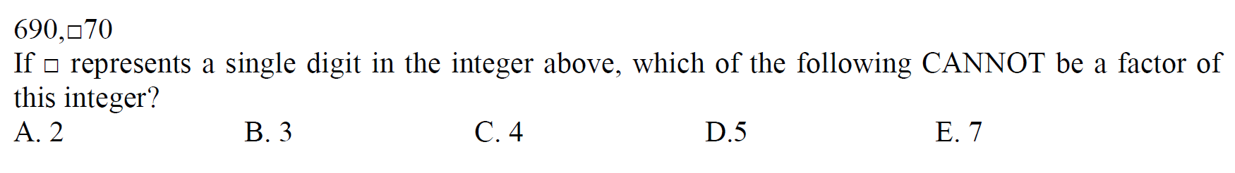
Factors and Prime Factors（因数和质因数）
Notes:
A
B
C

Slide 21
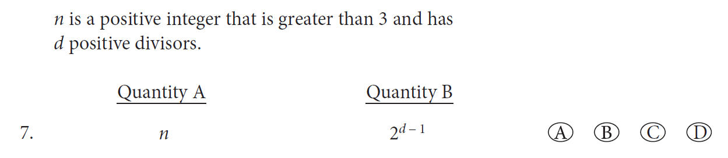
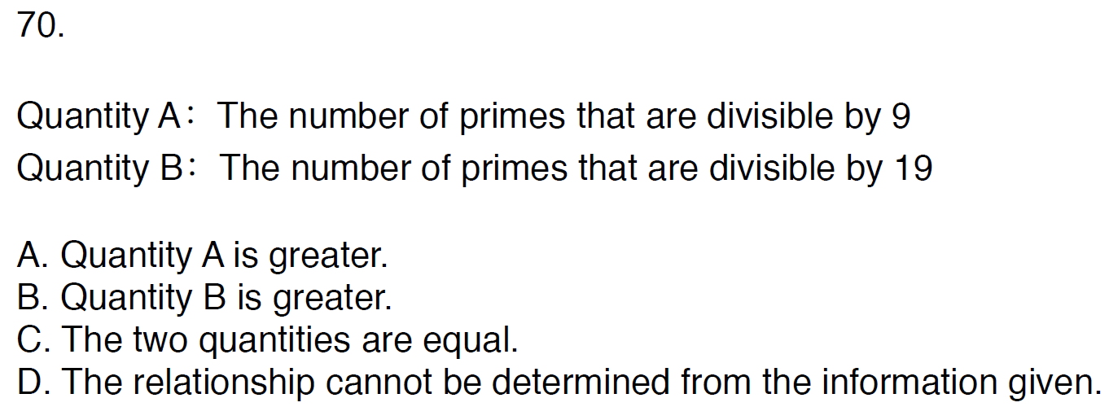
Factors and Prime Factors（因数和质因数）
Notes:
D
B

Slide 22
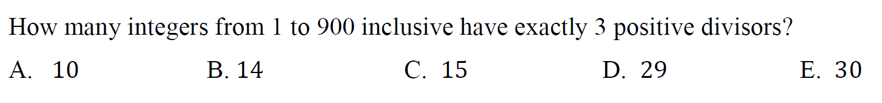
Factors and Prime Factors（因数和质因数）
Notes:
E
A

Slide 23
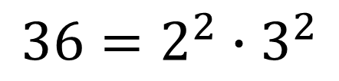
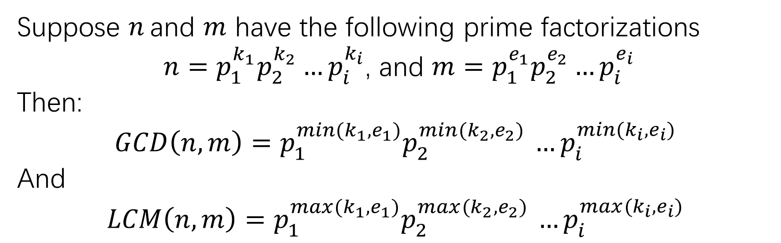
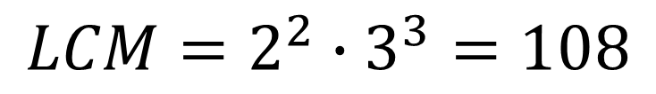
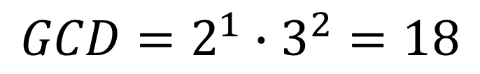
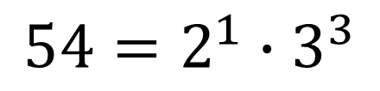
Greatest Common Divisors and Least Common Multiples
（最大公约数和最小公倍数）
Suppose $n$ and $m$ have the following prime factorizations
$n=p_{1}^{k_{1}}p_{2}^{k_{2}}…p_{i}^{k_{i}}$, and $m=p_{1}^{e_{1}}p_{2}^{e_{2}}…p_{i}^{e_{i}}$
Then:
$$GCD\left(n,m\right)=p_{1}^{min⁡(k_{1}, e_{1})}p_{2}^{min⁡(k_{2}, e_{2}) }…p_{i}^{min(k_{i}, e_{i})}$$
And
$$LCM\left(n,m\right)=p_{1}^{max⁡(k_{1}, e_{1})}p_{2}^{max⁡(k_{2}, e_{2}) }…p_{i}^{max⁡(k_{i}, e_{i})}$$
$$36=2^{2}∙3^{2}$$
$$GCD=2^{1}∙3^{2}=18$$
$$54=2^{1}∙3^{3}$$
$$LCM=2^{2}∙3^{3}=108$$

Slide 24
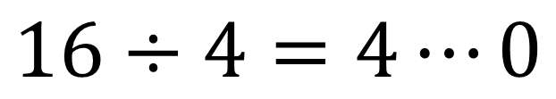
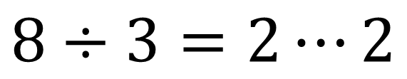
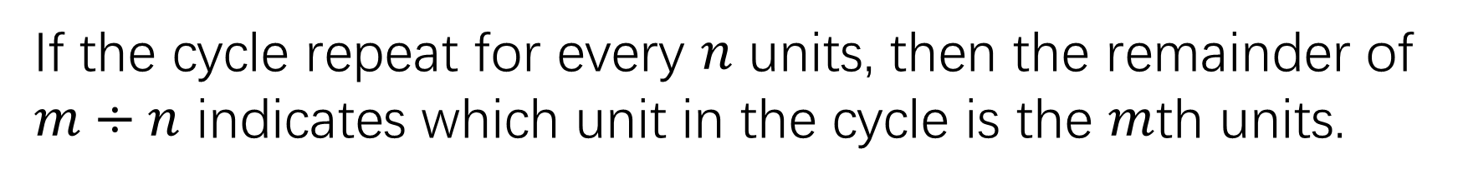
Remainders（余数）
$$8÷3=2⋯2$$
Remainder
Note: Remainder can be 0.
$$16÷4=4⋯0$$
Circulation（循环）:
If the cycle repeat for every $n$ units, then the remainder of $m÷n$ indicates which unit in the cycle is the $m$th units.

Slide 25
Remainders（余数）
Circulation of the units（个位数）of powers:
2 as base: 2, 4, 8, 6 as a cycle
3 as base: 3, 9, 7, 1 as a cycle
4 as base: 4, 6 as a cycle
7 as base: 7, 9, 3, 1 as a cycle
8 as base: 8, 4, 2, 6 as a cycle
9 as base: 9, 1 as a cycle

Slide 26
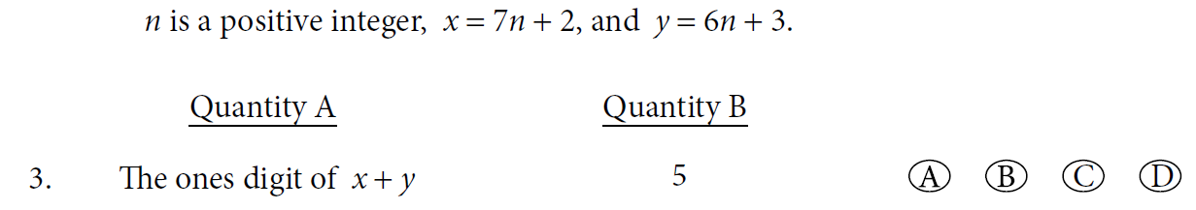
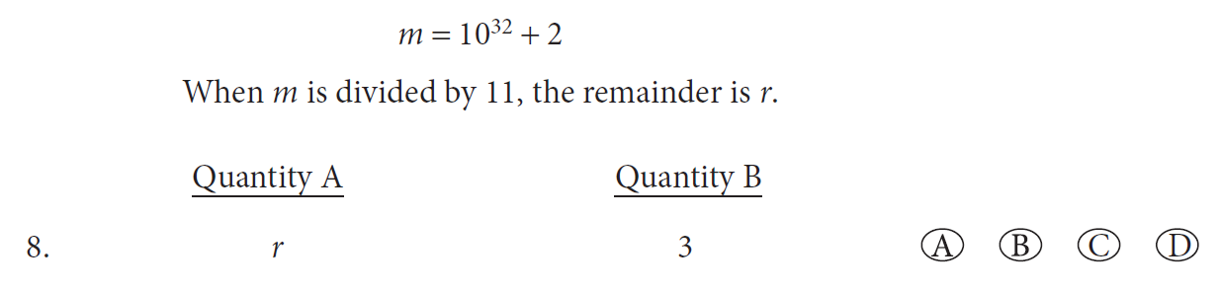
Remainders（余数）
Notes:
D
C

Slide 27
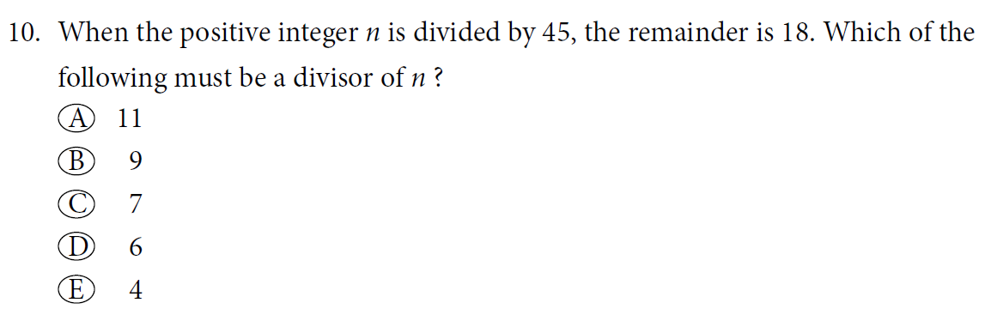
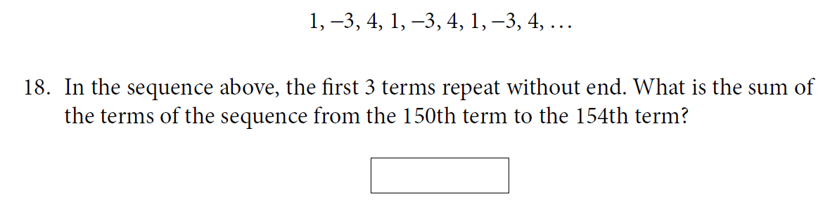
Remainders（余数）
Notes:
B
7

Slide 28
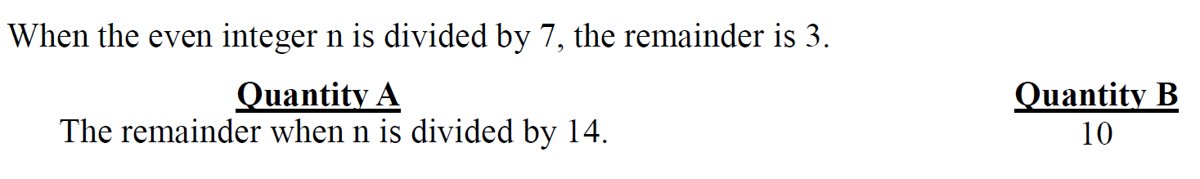
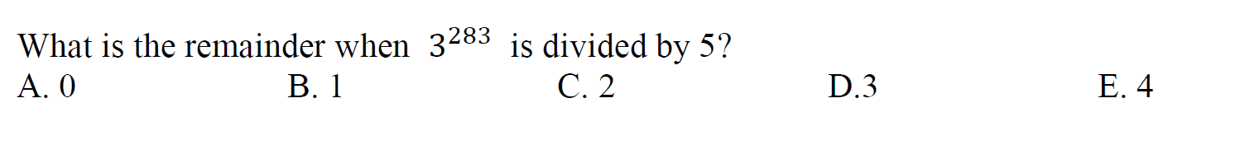
Remainders（余数）
Notes:
C
C

Slide 29
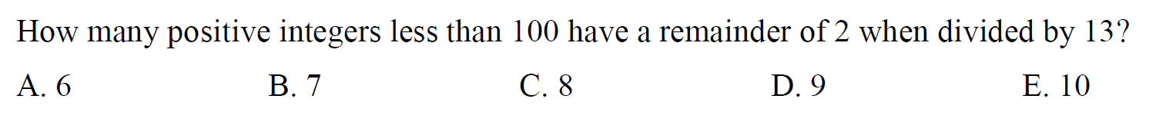
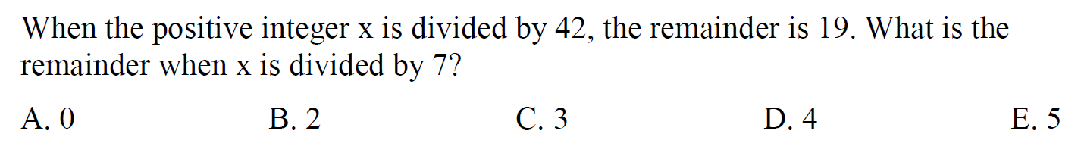
Remainders（余数）
Notes:
C
E

Slide 30
Decimals, Fractions, and Scientific Notation
（小数、分数和科学记数法）
Name of numbers in decimals:
Take 7654.321 as an example
“7”: thousands
“.” : decimal point
“6”: hundreds
“3”: tenths
“5”: tens
“2”: hundredths
“4”: units or ones
“1”: thousandths

Slide 31
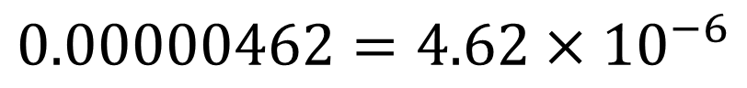
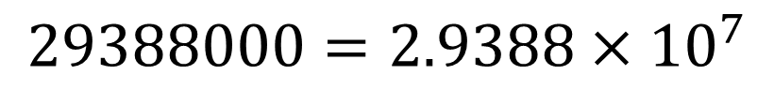
Decimals, Fractions, and Scientific Notation
（小数、分数和科学记数法）
Scientific notation（科学计数法）
Format: figure between 0 and 10 $×$ power of 10
Example:
$$0.00000462=4.62×{10}^{−6}$$
$$29388000=2.9388×{10}^{7}$$

Slide 32
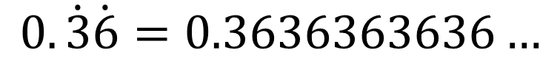
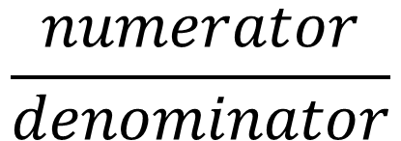
Decimals, Fractions, and Scientific Notation
（小数、分数和科学记数法）
Terminating decimals
The prime factors of denominator contains only 2 and 5
Fractions
$$\frac{numerator}{denominator}$$
Circulating decimals
$$0.\dot{3}\dot{6}=0.3636363636…$$
$$0.27\dot{3}1\dot{6}=0.27316316316316…$$

Slide 33
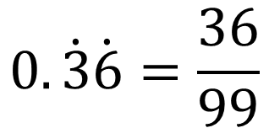

Decimals, Fractions, and Scientific Notation
（小数、分数和科学记数法）
Convert to fractions
Terminating decimals
Use power of 10 as denominator
$$0.36=\frac{36}{100}$$
Circulating decimal
If all digits circulate, use number contains only 9 as denominator
$$0.\dot{3}\dot{6}=\frac{36}{99}$$

Slide 34

Decimals, Fractions, and Scientific Notation
（小数、分数和科学记数法）
Notes:
B
18

Slide 35


Decimals, Fractions, and Scientific Notation
（小数、分数和科学记数法）
Notes:
E
A

Slide 36


Decimals, Fractions, and Scientific Notation
（小数、分数和科学记数法）
Notes:
A
C
B

Slide 37
The Algebra
代数计算

Slide 38




Ratios and Proportions（ 比例和比率）
Expression
The ratio of A to B:
$$A:B$$
$A=2B$ or $\frac{A}{B}=2$
Twice as much A as B:
What percent/proportion/fraction of A is B?
$$\frac{B}{A}$$
x percent of y:
$$x\%∙y$$
What is the percent increase from A to B?
Base on A
What percent is A greater than B?
Base on B

Slide 39


Ratios and Proportions（ 比例和比率）
Notes:
D
D

Slide 40


Ratios and Proportions（ 比例和比率）
Notes:
E
E

Slide 41


Ratios and Proportions（ 比例和比率）
Notes:
2500
D

Slide 42





Rules of Exponents（指数运算）
$a^{m}∙a^{n}$= $a^{m+n}$
$$\frac{a^{m}}{a^{n}}=a^{m−n}$$
$${(a^{m})}^{n}=a^{m∙n}$$
$a^{m}∙b^{m}$= ${(ab)}^{m}$
$$\frac{a^{m}}{b^{m}}={(\frac{a}{b})}^{m}$$

Slide 43



Rules of Exponents（指数运算）
Notes:
C
C
A

Slide 44



Rules of Exponents（指数运算）
Notes:
D
D
B

Slide 45


Rules of Exponents（指数运算）
Notes:
E
6.75
AC

Slide 46




Solving Equations（解方程）
For general equation $ax^{2}+bx+c=0$,
if discriminant $∆ =b^{2}−4ac≥0$
The solutions are: $x=\frac{−b±\sqrt{b^{2}−4ac}}{2a}$
If the equation can be written as $(a_{1}x+c_{1})(a_{2}x+c_{2})=0$
The solutions are: $x_{1}=−\frac{c_{1}}{a_{1}}$, and $x_{2}=−\frac{c_{2}}{a_{2}}$

Slide 47


Solving Equations（解方程）
For general system of equations $\left\{\begin{aligned}a_{1}x+b_{1}y=c_{1} \\ a_{2}x+b_{2}y=c_{2}\end{aligned}\right.$,
The solutions can be obtained by either:
Substituting
Adding or subtracting
Note: the two equations in system must be different equations.
$$\left\{\begin{aligned}2x+4y=6 \\ x+2y=3\end{aligned}\right.$$

Slide 48



Solving Equations（解方程）
Notes:
C
B
B

Slide 49


Solving Equations（解方程）
Notes:
A
12
D

Slide 50


Solving Equations（解方程）
Notes:
7.2
D

Slide 51




Inequalities（不等式）
Linear inequalities（线性不等式）:
Follow the same rule as solving linear equations except:
Change direction if multiplying negative number or taking reciprocal.
$$−7<−3$$
$$7>3$$
$$−\frac{1}{7}>−\frac{1}{3}$$
$$\frac{1}{7}<\frac{1}{3}$$

Slide 52











Inequalities（不等式）
Graphs of some functions:
$$\sqrt[3]{x}$$
$$\sqrt{x}$$
$$x$$
$$x^{2}$$
$$x^{3}$$
$$x^{4}$$
Comparing the functions:
$$x<−1$$
$−1<x<0$
$$0<x<1$$
$$1<x$$
Absolute values（绝对值）:
$$\left|x\right|=\left\{\begin{aligned}x, if x≥0 \\ −x, if x<0\end{aligned}\right.$$
Notes:
Draw out the graphs

Slide 53


Inequalities（不等式）
Notes:
B
D

Slide 54


Inequalities（不等式）
Notes:
-2
D
ABCDEH

Slide 55



Inequalities（不等式）
Notes:
A
D
E

Slide 56

Inequalities（不等式）
Notes:
DEF

Slide 57





Sequences（数列）
Arithmetic sequences（等差数列）
$$a_{n}=a_{1}+\left(n−1\right)d$$
$S_{n}=na_{1}+\frac{n\left(n−1\right)}{2}d$ or $\frac{n(a_{1}+a_{n}) }{2}$
Geometric sequences（等比数列）
$$a_{n}=a_{1}q^{n−1}$$
$$S_{n}=\frac{a_{1}(1−q^{n})}{1−q}$$
If $\left|q\right|<1$, $\lim_{n→∞}{S_{n}}=\frac{a_{1}}{1−q}$

Slide 58


Sequences（数列）
Notes:
D
B

Slide 59

Sequences（数列）
Notes:
ACE

Slide 60


Triangles（三角形）
Properties of triangles:
Sum of three angles: $180°$
Sum of two sides $>$ the other side
Large side facing large angle
Sum of all angles in polygons with $n$ sides: $(n−2)180°$

Slide 61

















Triangles（三角形）
A
Pythagorean theory:
In right triangle $∆ABC$,
${AC}^{2}+$ ${BC}^{2}={AB}^{2}$
C
B
Some special right triangles
$$2$$
$$\sqrt{2}$$
$$5$$
$$13$$
$$1$$
$$60°$$
$$1$$
$$12$$
$$45°$$
$$3$$
$$30°$$
$$\sqrt{3}$$
$$1$$
$$4$$
$$5$$

Slide 62



Triangles（三角形）
A
Area of triangles
$$S_{∆ABC}=\frac{BC×AD}{2}$$
C
B
D
For equilateral triangle with side length $a$
A
$$S_{∆ABC}=\frac{\sqrt{3}}{4}a^{2}$$
C
D
B

Slide 63


Triangles（三角形）
Notes:
C
D

Slide 64


Triangles（三角形）
Notes:
B
D

Slide 65


Triangles（三角形）
Notes:
B C E G
112.5

Slide 66






Circles（圆）
For circle with radius $r$
Area: $S=πr^{2}$
Perimeter or Circumference:
$$C=2πr$$
For arc in the circle with radius $r$
Length of arc: $L=\frac{x}{360}∙2πr$

Slide 67


Circles（圆）
Notes:
B
B

Slide 68

Circles（圆）
Notes:
E

Slide 69



Solid Geometry（立体几何）
Volumes of :
Rectangular solids: $V=length×width×height$
Cubes: $V={Side}^{3}$
Cylinders: $V=π×{radius}^{2}×height$
Spheres or balls: $V=\frac{4}{3}×π×{radius}^{3}$

Slide 70


Solid Geometry（立体几何）
Notes:
D
10

Slide 71




Plane Rectangular Coordinate Geometry
（平面直角坐标几何）
Distance between two points:
$$d=\sqrt{{(x_{1}−x_{2})}^{2}+{(y_{1}−y_{2})}^{2}}$$
For general linear function $y=kx+b$
$k$ is slope or gradient（斜率）
$b$ is y-intercept（截距）
$$k=\frac{y_{1}−y_{2}}{x_{1}−x_{2}}$$

Slide 72





Plane Rectangular Coordinate Geometry
（平面直角坐标几何）
$$\left\{\begin{aligned}y=k_{1}x+b_{1} \\ y=k_{2}x+b_{2}\end{aligned}\right.$$
1. $k_{2}≠k_{1}$
Intersects in one point（一个交点）
2. $k_{2}=k_{1},b_{1}=b_{2}$
Identical（重合)
3. $k_{2}=k_{1},b_{1}≠b_{2}$
Parallel（平行）
4. $k_{1}∙k_{2}=−1$
Perpendicular（垂直）

Slide 73






Plane Rectangular Coordinate Geometry
（平面直角坐标几何）
Symmetry of points:
For point $(x, y)$
Reflected in x axis
$$(x, −y)$$
Reflected in y axis
$$(−x, y)$$
Reflected in origin
$$(−x, −y)$$
Reflected in line $y=x$
$$(y, x)$$

Slide 74


Plane Rectangular Coordinate Geometry
（平面直角坐标几何）
Notes:
D
A

Slide 75


Plane Rectangular Coordinate Geometry
（平面直角坐标几何）
Notes:
B D
17

Slide 76


Plane Rectangular Coordinate Geometry
（平面直角坐标几何）
Notes:
C
A

Slide 77

Plane Rectangular Coordinate Geometry
（平面直角坐标几何）
Notes:
A C D

Slide 78
The Word Problems
文字应用题

Slide 79
Sets（集合）
Venn diagram:

Slide 80

Sets（集合）
Notes:
B
121

Slide 81


Sets（集合）
Notes:
B C D E F
A

Slide 82



Permutation, Combination and Probability
（排列、组合和概率）
1. Combination:
$$C_{m}^{n}=\frac{m!}{n!\left(m−n\right)!}$$
$$C_{m}^{n}=C_{m}^{m−n}$$
2. Permutation:
$$P_{m}^{n}=C_{m}^{n}P_{n}^{n}=\frac{m!}{\left(m−n\right)!}$$

Slide 83

Permutation, Combination and Probability
（排列、组合和概率）
3. Probability:
$$P(E)=\frac{Event E}{All possible result}$$
Same Probability for each event?
Independent event?

Slide 84


Permutation, Combination and Probability
（排列、组合和概率）
Notes:
B
A

Slide 85


Permutation, Combination and Probability
（排列、组合和概率）
Notes:
153/190
BC

Slide 86

Descriptive Statistics（描述统计学）
1. Average (Arithmetic mean)（算术平均数）
2. Medium（中位数）
3. Mode（众数）
5. Variance（方差）
4. Range（极差）
6. Standard Deviation（标准差）
box‑and‑whisker plots

Slide 87


Descriptive Statistics（描述统计学）
Property 1: The mean, median, and mode are exactly the same.
Property 2: The distribution is perfectly symmetric about the mean.
Property 3: About two-thirds of the data are within 1 standard deviation of the mean.
Property 4: Almost all of the data are within 2 standard deviations of the mean.

Slide 88


Descriptive Statistics（描述统计学）
$$z=\frac{x−m}{σ}$$
Standardization：

Slide 89


Descriptive Statistics（描述统计学）
Notes:
A
D

Slide 90


Descriptive Statistics（描述统计学）
Notes:
C
C

Slide 91


Descriptive Statistics（描述统计学）
Notes:
E
B

Slide 92


Descriptive Statistics（描述统计学）
Notes:
B
B

Slide 93

Descriptive Statistics（描述统计学）
Notes:
A

Slide 94

Data Presenting（数据呈现）
Table
Bar graph
Segmented bar graph
Histogram
Circle graph (pie chart)
Scatterplot
Line graph

Slide 95


Data Presenting（数据呈现）
Notes:
B

Slide 96

Data Presenting（数据呈现）
Notes:
D

Slide 97

Data Presenting（数据呈现）
Notes:
A

Slide 98

Data Presenting（数据呈现）
Notes:
C

Slide 99


Data Presenting（数据呈现）
Notes:
B

Slide 100

Data Presenting（数据呈现）
Notes:
C

Slide 101

Data Presenting（数据呈现）
Notes:
B C

Slide 102

Data Presenting（数据呈现）
Notes:
E

